Slide 1
Esri Enrichment Tool (Beta)
Using Scripts for Enrichment
January, 2025

Slide 2
Content
Background and Context
Script-based Enrichment Tool and Demo
Best practices and Caveats

Slide 3
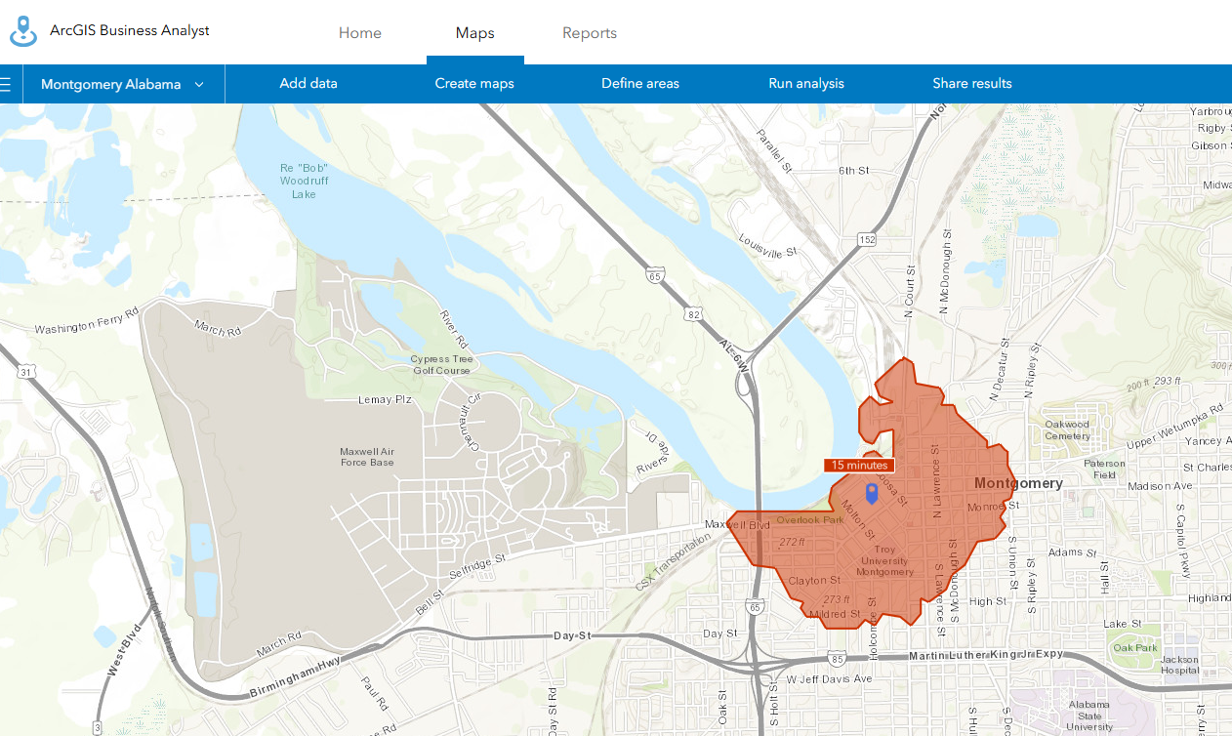
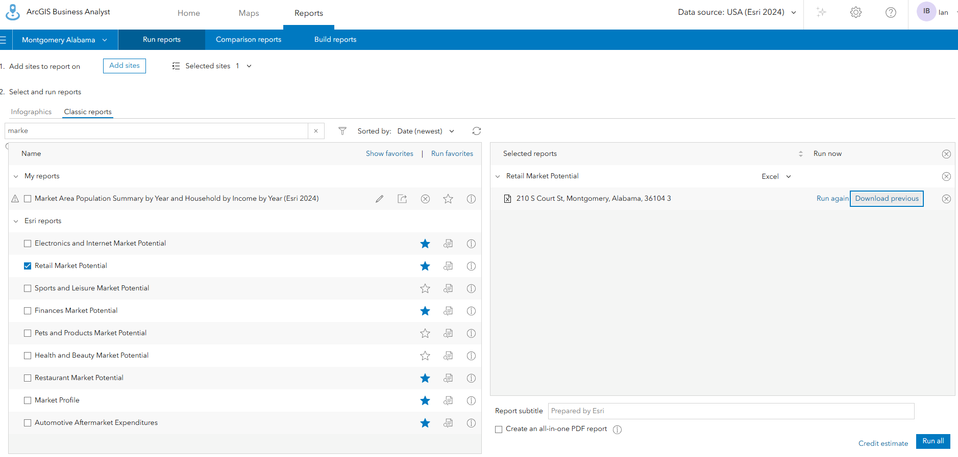
Background: Esri Business Analyst Online (BAO)
https://bao.arcgis.com/esriBAO/index.html
An online platform for business and demographic analysis
Provides spatial enrichment data for selected sites
Generate reports per place/combined areas

Slide 4
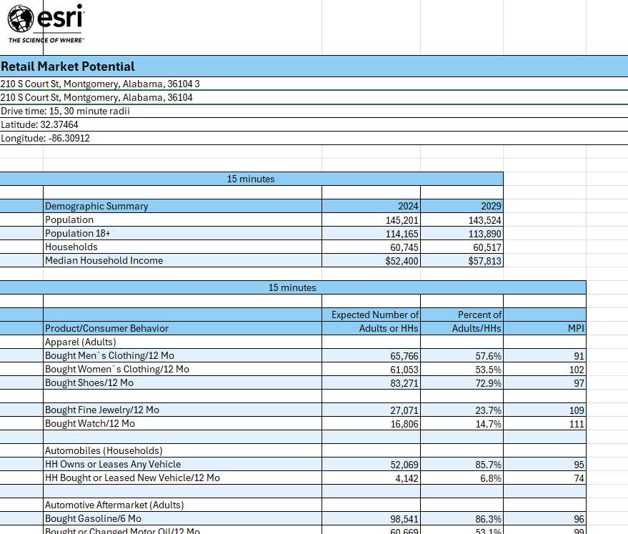
Context
Difficulties when using BAO for TOD
Limited batch processing
One location/area at a time
Cost-effectiveness
10 Esri Credits per report, potential high cost for batch processing (20 locations)
Manual data export/import
Clean the data for analysis

Slide 5
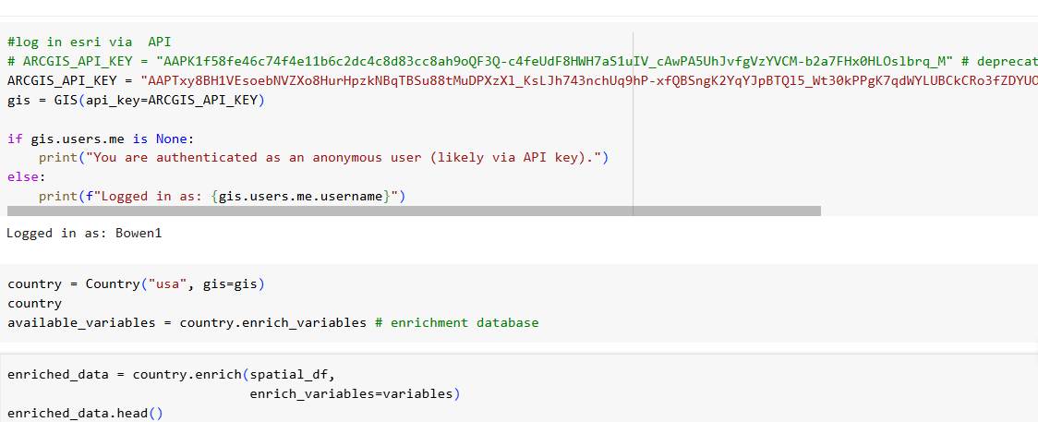
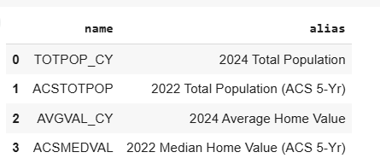
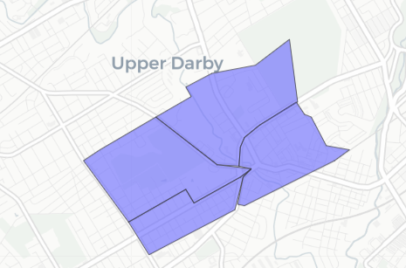
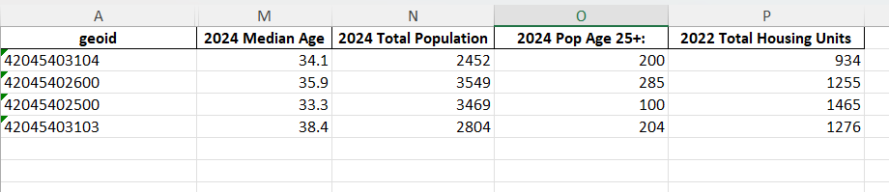
Accessing BAO Using Scripts/API
Input: List of variables + shapefile
ArcGIS API for Python, GeoEnrichment Service
Output : .xlsx file for next step analysis

Slide 6

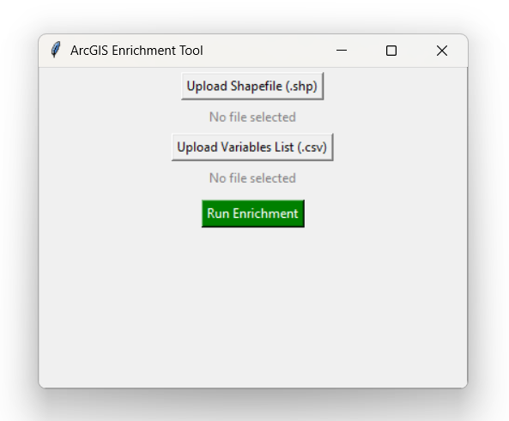
Script-based Enrichment Tool and Demo
Using Python Scripts
✅ Fully automated workflow ✅ Batch processing for multiple locations ✅ Customizable analysis
Credit Costs
GeoEnrichment consumes credits based on data usage. 1,000 data variables = 10 credits --> 0.01 credit per data point
Example: 20 points/locations x 100 variables = 2,000 data variables = 20 credits
File Path on ESI’s O drive: \\econha01\client\Arcgis Application

Slide 7
Best practices and Caveats for enrichment tool
Read the Readme file before you use the tool!
File Path on ESI’s O drive: \\econha01\client\Arcgis Application
Best Usage Scenario: Batch processing and a set of variables is needed.
Data Availability: Archive years are not always available in Esri Enrichment and BAO. Only the current year, the latest ACS 5-year data and 2010 & 2020 census data are available for certain variables.
Credits Usage: Can not run the tool if credits run out.
Maximum Study Areas per Enrichment Request: 100 locations, service limits may apply when processing large datasets.
API Expiration: API access is only valid for one year and must be renewed annually.
Variable Selection: Manual selection of variables beforehand, DO NOT run the whole variable database.
Report vs. API Differences: BAO reports may show slightly different numbers due to customization options. BAO allows boundary generalization for performance, while GeoEnrichment strictly follows the shapefile boundary.
Python scripts and colab notebooks are available if prefer adding data analysis steps before and after running enrichment tool.

Slide 8
Try it out and feedback is welcomed! Thank you!
Notes:
Reference:
https://community.esri.com/t5/esri-startup-program-blog/add-intelligence-to-your-apps-amp-maps-with-rich/ba-p/883069#:~:text=If%20you%20consume%201%2C000%20data%20variables%20you,information%20around%20each%20%E2%80%93%20say%2C%20two%20variables%2C
https://developers.arcgis.com/rest/geoenrichment/api-reference/data-apportionment.htm
https://developers.arcgis.com/rest/geoenrichment/api-reference/service-limits.htm
https://developers.arcgis.com/python/latest/guide/part1-introduction-to-geoenrichment/#:~:text=Local%20GeoEnrichment%20Source,supported%20with%20a%20local%20source
https://resources.arcgis.com/en/help/main/10.1/#/Data_tab/000z000000v7000000/
https://doc.arcgis.com/en/business-analyst/web/data.htm#ESRI_SECTION1_2126D2604E87419B9145B96C6775B207

